Slide 1
COURSE NAME: COURSE CODE:
ARTIFICIAL INTELLIGENCE
CIS 412
SYED TANGIM PASHA
LECTURER,
DEPARTMENT OF COMPUTING AND INFORMATION SYSTEM (CIS)
DAFFODIL INTERNATIONAL UNIVERSITY (DIU)
DHAKA,BANGLADESH

Slide 2
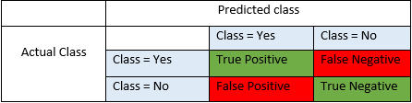
CONFUSION MATRIX
Confusion Matrix: A confusion matrix is a performance measurement for machine learning algorithms.

Slide 3
TRUE POSITIVE, TRUE NEGETIVE
True Positive (TP): These are the correctly predicted positive values which means that the value of actual class is yes and the value of predicted class is also yes. Example: If actual class value indicates that this passenger survived and predicted class tells you the same thing.
True Negative (TN): These are the correctly predicted negative values which means that the value of actual class is no and value of predicted class is also no. Example: if actual class says this passenger did not survive and predicted class tells you the same thing.

Slide 4
FALSE POSITIVE, FALSE NEGATIVE
False Positive (FP): When actual class is no and predicted class is yes. Example: if actual class says this passenger did not survive but predicted class tells you that this passenger will survive.
False Negative (FN): When actual class is yes but predicted class is no. Example: if actual class indicates that this passenger survived and predicted class tells you that passenger will die.

Slide 5
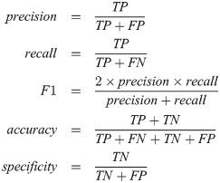
PRECISION
Precision: Precision is the ratio of correctly predicted positive observations to the total predicted positive observations. High precision relates to the low false positive rate.
Example: you would want greater precision is spam filters. A greater number of false positives in a spam filter would mean that one or more important emails could be tagged as spam and moved in spam folders.

Slide 6
RECALL
Recall: Recall is the ratio of correctly predicted positive observations to the all observations in actual class-yes.
Example: In medical diagnosis, the recall score should be extremely high otherwise greater number of false negative would prove to be fatal for life of patients.

Slide 7
F1 SCORE
F1-Score: F1 score is the weighted average of Precision and Recall. That is, a good F1 Score means that you have low false positive and low false negatives. An F1 score is considered perfect when it’s 1, while the model is a total failure when it’s 0.

Slide 8
ACCURACY
Accuracy: Accuracy is the most intuitive performance measure and it is simply a ratio of correctly predicted observation to the total observations.
Accuracy can tell us immediately whether a model is being trained correctly and how it perform generally.

Slide 9
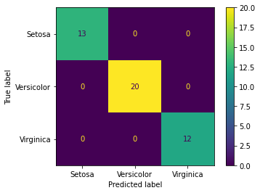
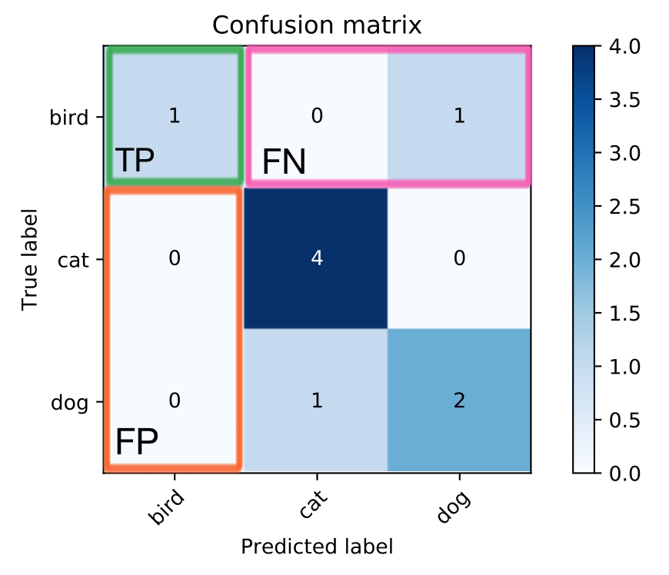
KNN

Slide 10

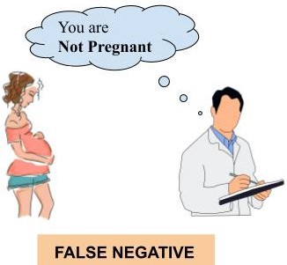

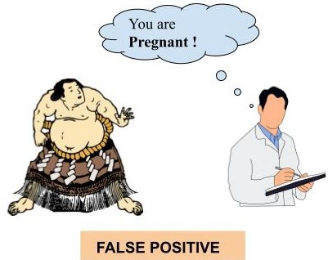
EXAMPLE

Slide 11
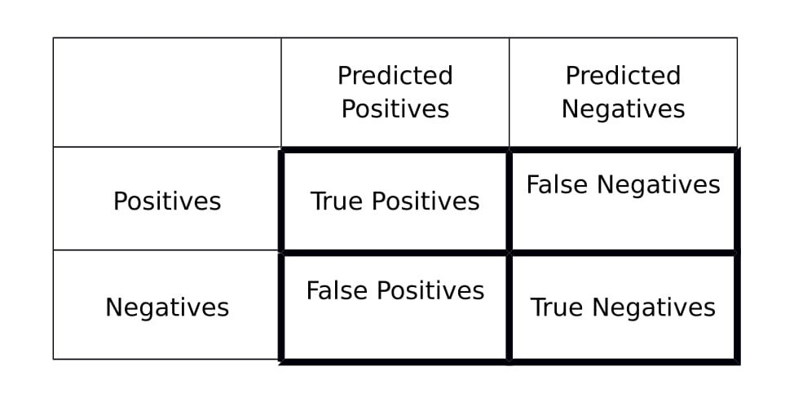
EXAMPLE
We will now go back to the earlier example of classifying 100 people (which includes 40 pregnant women and the remaining 60 are not pregnant women and men with a fat belly) as pregnant or not pregnant. Out of 40 pregnant women 30 pregnant women are classified correctly and the remaining 10 pregnant women are classified as not pregnant by the machine learning algorithm. On the other hand, out of 60 people in the not pregnant category, 55 are classified as not pregnant and the remaining 5 are classified as pregnant.

Slide 12
EXAMPLE
TN = 55, FP = 5, FN = 10, TP = 30
PRECISION=TP/(TP+FP)=30/(30+5) = 0.857
RECALL=TP/(TP+FN)=30/(30+10) = 0.75
F1-SCORE=2*(PRECISION * RECALL)/
(PRECISION + RECALL)=
2*(0.857*0.75)/(0.857+0.75)=0.799
ACCURACY= (TN+TP)/(TN+FP+TP+FN)=
(55+30)/(55+5+30+10) = 0.85

